Slide 1
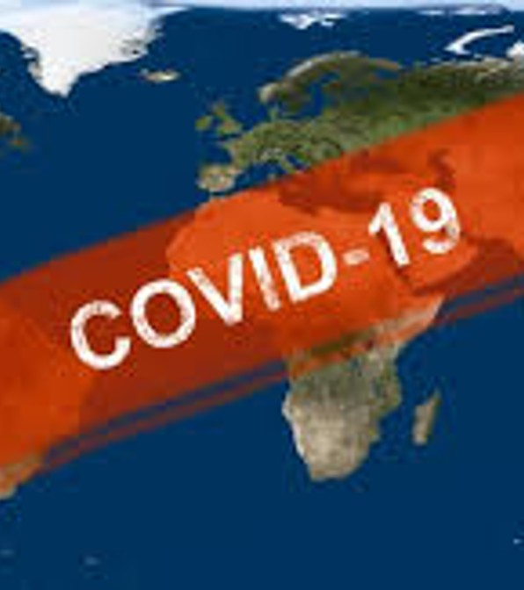
Global COVID-19 Vaccination Analysis Strategic Forecasting for Public Health Planning Team: Lisa – Presenter & Slide Designer Sarah – Data Scientist Ryan – Data Wrangler

Slide 2

Understanding Global Vaccination Trends
The COVID-19 pandemic required rapid vaccination programs worldwide.
Strategic planning depends on understanding how these programs are performing.
Accurate forecasting helps healthcare leaders allocate resources, staff, and outreach effectively.
This analysis compares vaccination patterns in the United States and India to support public health decisions.

Slide 3
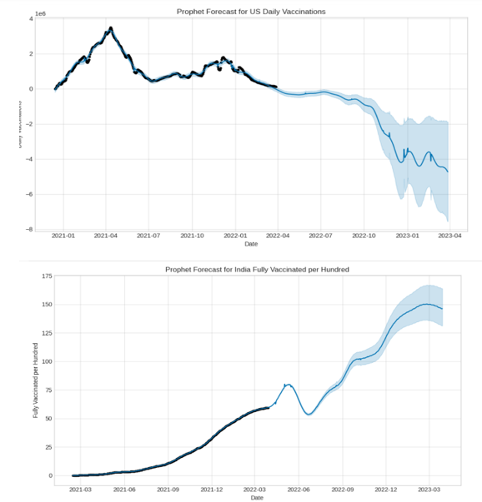
Hypothesis & Methodology
Hypothesis: Forecasting models can identify patterns and predict future vaccination trends; the U.S. is expected to show declining daily vaccinations, and India is expected to show continued cumulative growth.
Model: Prophet with country‑specific holidays, weekly and yearly seasonality; 365‑day projection.
Outputs: Forecast, uncertainty intervals, and component breakdowns (trend, holidays, weekly, yearly).
Data: U.S. — 470 daily vaccination counts; India — 399 percent‑fully‑vaccinated values.
Figure 1.1. Prophet forecast — United States (daily vaccinations, top) over India (percent fully vaccinated, bottom). Fitted values with 365‑day point forecasts and shaded uncertainty intervals.

Slide 4
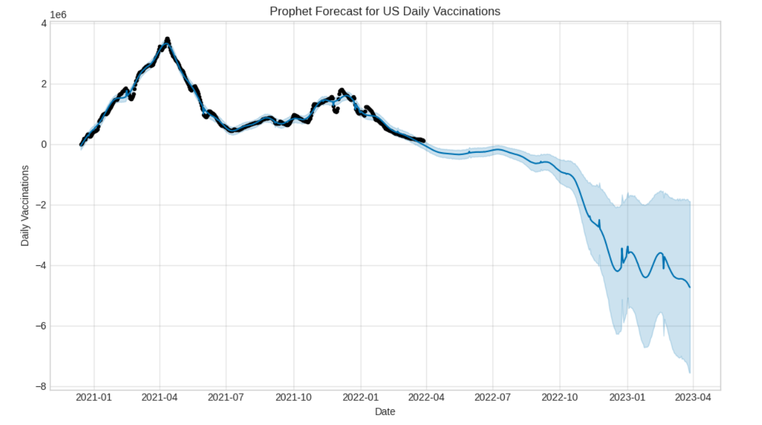
US FINDINGS-DAILY VACCINATION TRENDS
Primary insight: Daily vaccinations peaked in mid‑2021 and declined through 2022–2023.
Operational note: Weekend and holiday effects create predictable short‑term dips.
High‑level recommendation: Prepare flexible staffing/supply plans to handle low and intermittent high demand.
Uncertainty: Forecast uncertainty widens over the projection horizon.
Figure 2.0. Prophet forecast — United States daily vaccinations. Fitted values with 365‑day point forecast and shaded uncertainty intervals.
Historical peak — mid‑2021
Forecast decline; widening uncertainty

Slide 5
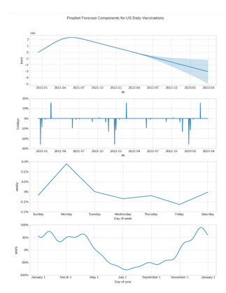
US DRIVERS & ACTION
Drivers identified:
Weekly seasonality: Weekend troughs reduce throughput.
Holidays: Distinct spikes/dips tied to specific dates.
Yearly seasonality: Seasonal peaks present targeting windows.
Actionable items:
Expand weekend access to reduce weekly troughs.
Schedule campaigns around seasonal peaks to maximize uptake.
Use uncertainty bands to create contingency staffing and supply triggers
Figure 3.0
Prophet components: United States
Prophet component decomposition for U.S. vaccinations showing the underlying trend, holiday effects, weekly (day‑of‑week) pattern, and yearly seasonality; use this to identify weekend troughs, holiday dips/spikes, and seasonal windows for operational planning.

Slide 6
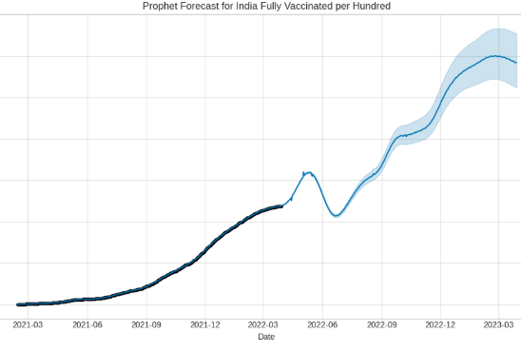
India’s Findings-Cumulative Coverage
Primary insight: India shows steady growth in percent fully vaccinated with continued upward momentum. Growth dynamics: Rate of increase is slowing as coverage rises, indicating approaching saturation in many regions.
Operational note: Day‑of‑week and weekly seasonality produce short dips, but cumulative progress remains robust.
High‑level recommendation: Shift from broad mass campaigns to targeted outreach for remaining unvaccinated pockets.
Figure 4.0
Prophet forecast: India
Prophet model fit and 365‑day forecast for India percent fully vaccinated, showing fitted cumulative trend with shaded uncertainty intervals and a slowing marginal growth as coverage approaches saturation.
Continued expansion of coverage
Slowing growth → targeted outreach

Slide 7
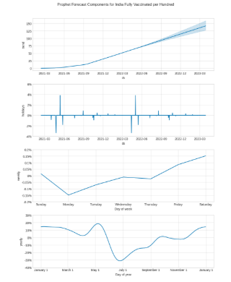
India Drivers & Actions
Drivers identified:
Weekly/day‑of‑week: Weekend troughs reduce short‑term throughput.
Yearly seasonality: Seasonal peaks indicate high‑impact windows.
Actionable items:
Extend weekend and flexible-hour access to reach working populations.
Target outreach to low‑coverage districts using micro‑planning and mobile teams.
Schedule focused campaigns during seasonal peaks to maximize uptake.
Use component insights to prioritize limited resources where they’ll have the greatest marginal impact.
Figure 5 — Prophet components: India
Prophet component decomposition for India showing trend, weekly/day‑of‑week effects, holiday impacts, and yearly seasonality; used to identify weekend troughs, seasonal peaks, and timing for targeted outreach.
Components explain drivers; actions translate those drivers to operational plans.

Slide 8
Comparative Insights & Strategic Recommendations
Comparative snapshot: U.S. shows declining daily vaccinations with widening forecast uncertainty; India shows continued cumulative growth with slowing marginal gains.
Strategic priority: Use country‑specific tactics — stabilize throughput in the U.S.; shift to targeted outreach in India.
Resource guidance: Allocate flexible staffing and buffer supplies in the U.S.; concentrate mobile teams and micro‑planning resources in India.
Shared operational pattern: Both countries display weekend troughs and holiday effects that reduce short‑term throughput.
Figure 6 — Stacked comparison: United States and India Prophet forecasts
Side‑by‑side stacked plots of U.S. and India Prophet forecasts showing fitted values and 365‑day uncertainty bands; used to contrast declining U.S. daily throughput with India’s cumulative growth and relative forecast uncertainty.

Slide 9
Three Prioritized Actions
U.S. — Build flex plans: Use uncertainty bands to trigger staffing/supply scale‑up or scale‑down thresholds.
India — Target remaining pockets: Deploy mobile teams, extended hours, and micro‑plans in low‑coverage districts.
Both — Exploit timing: Schedule campaigns around seasonal peaks and reduce operational gaps on weekends and holidays.

Slide 10
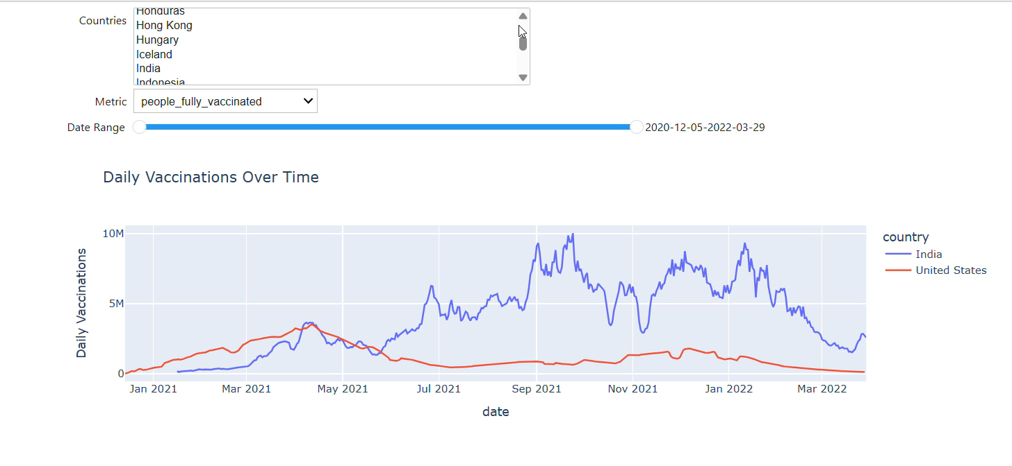
In the Works — Interactive Forecast Explorer
Figure 7 — Interactive dashboard
Interactive dashboard screenshot showing country filters, smoothing controls, hover tooltips, scenario overlays, and export options for live scenario testing and stakeholder brief exports.
This demo highlights how the dashboard turns forecast insights into operational decisions in real time.

Slide 11

Summary
U.S.: Declining daily vaccinations with widening forecast uncertainty — use flexible staffing and supply triggers.
India: Continue cumulative growth with slowing marginal gains — pivot to targeted outreach and mobile teams.
Common levers: Reduce weekend troughs, timing campaigns to seasonal peaks, and use component insights to prioritize resources.

Slide 12

Questions & Answers

Slide 13

Thank you
Lisa Hansen — Project Presenter
Sarah Yawn — Data Scientist
Ryan Weeks — Data Wrangler

